Slide 1
Misaligned HG00-HG00 RX TTL
Rx-Tx beam | HG00-HG00
Plots | Regular and Total LPS [nm], DWS [rad] ; Slopes [nm/rad], [rad/rad]
Longitudinal offset | 10 mm

Slide 5
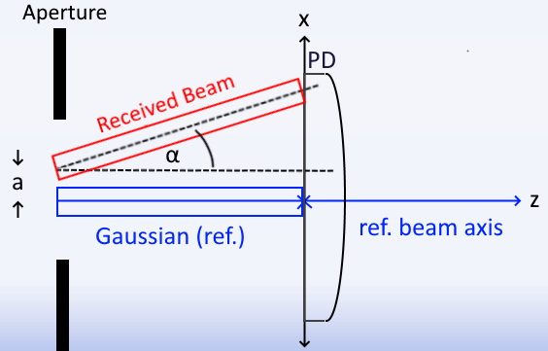
Misaligned Tophat-HG00 RX TTL
Rx-Tx beam | TH-HG00 (mode order 34)
Plots | Regular and Total LPS [nm], DWS [rad] ; Slopes [nm/rad], [rad/rad]
Longitudinal offset | 10 mm
How high: convergence with Alex’s results
How low: justifying 1st order shift expansion
How fast: computation times up to 7th order tilt

Slide 6
SUMMARY:
Higher order results
4th order tilt,4th order shift -> 7th order tilt,7th order shift
Very broad convergence with Alex at 7th order
Tilt & Shift Orders | “Accuracy” Range [urad]
4 & 4 | 200
5 & 5 | 300
6 & 6 | 400
7 & 7 | 400

Slide 7
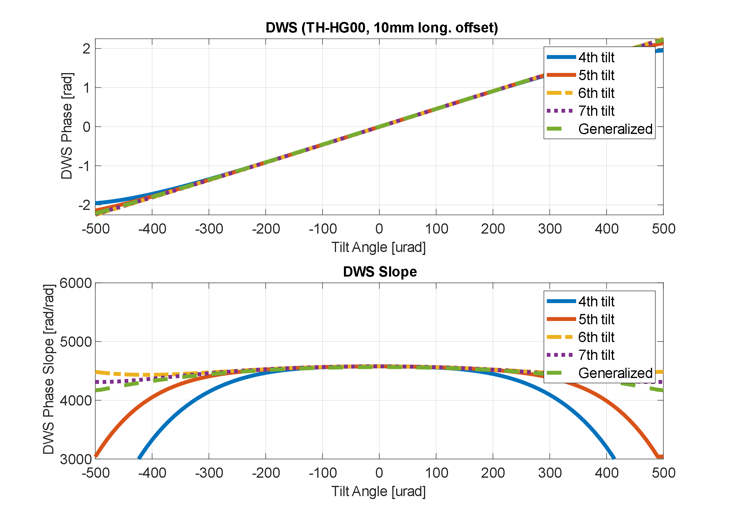
Higher order results
DWS
& shift

Slide 8
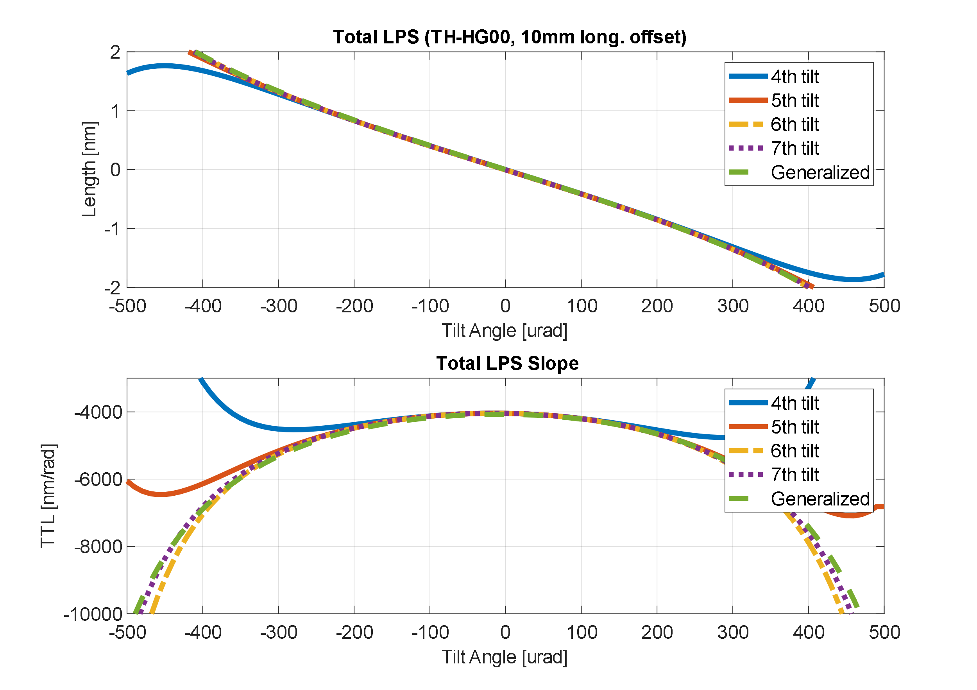
Higher order results
& shift
LPS
Tot.
& shift

Slide 9
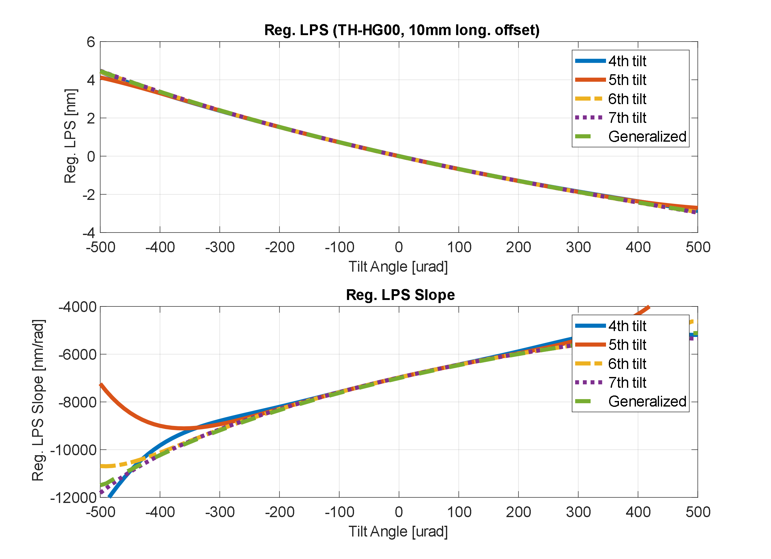
Higher order results
& shift
LPS
Reg.
& shift

Slide 10
SUMMARY:
Lower order shift
(100 um offset)
Expansion orders:
1st shift, 3rd & 4th tilt
3rd or 4th shift, 3rd or 4th tilt
1st order shift likely sufficient

Slide 11
Lower Order Shift?
100 um offset
DWS

Slide 12
Lower Order Shift?
100 um offset
LPS Tot.

Slide 13
Lower Order Shift?
100 um offset
LPS
Reg.

Slide 14
Get signals in two main steps:
SUMMARY:
Computation Times
Update mode coefficients
Integrate
Tilt Order (shift order = 1) | Time [s] | “Accuracy” Range [urad]
3 | 3.2 | 200
4 | 5.2 | 200
5 | 8.4 | 300

Slide 19
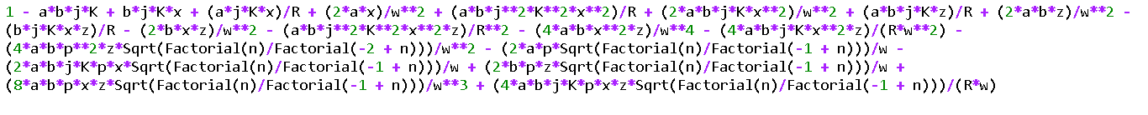
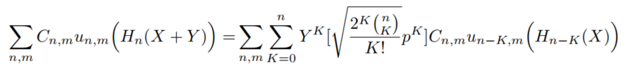

Speedup Structure
Mathematica strings
tilt
shift
[10,10]
Python parse
p_order
x_order
[x_order,p_order]
herm. poly.
x-coord.
Raw coefficients
m
n
~[n,m]

Slide 21
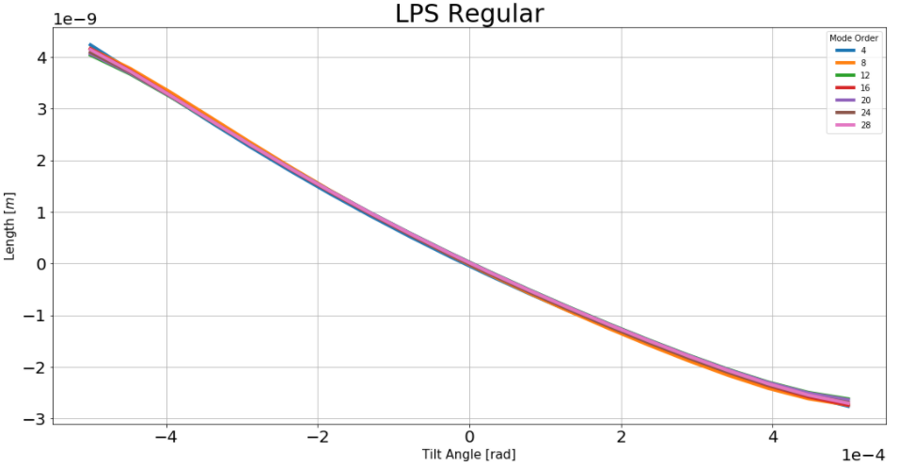
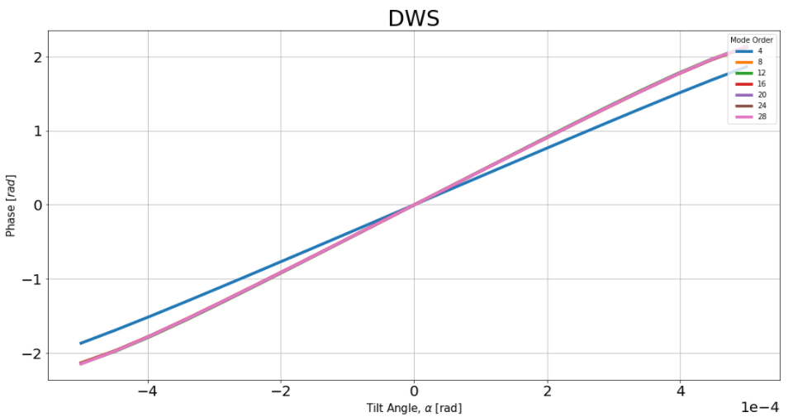
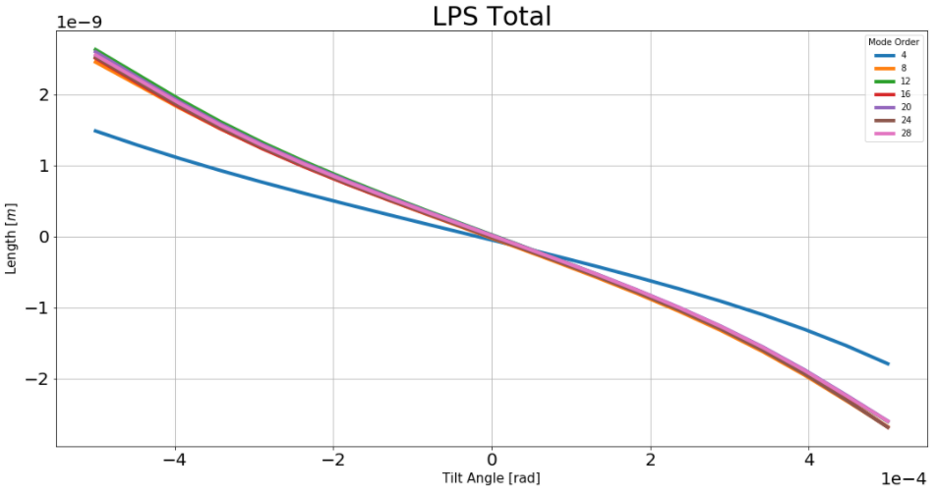

Slide 22
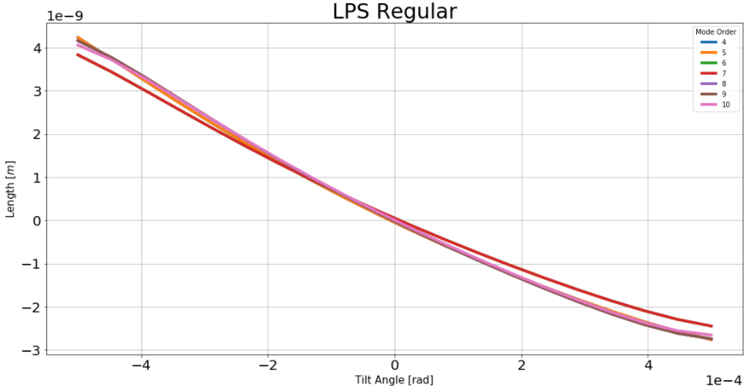
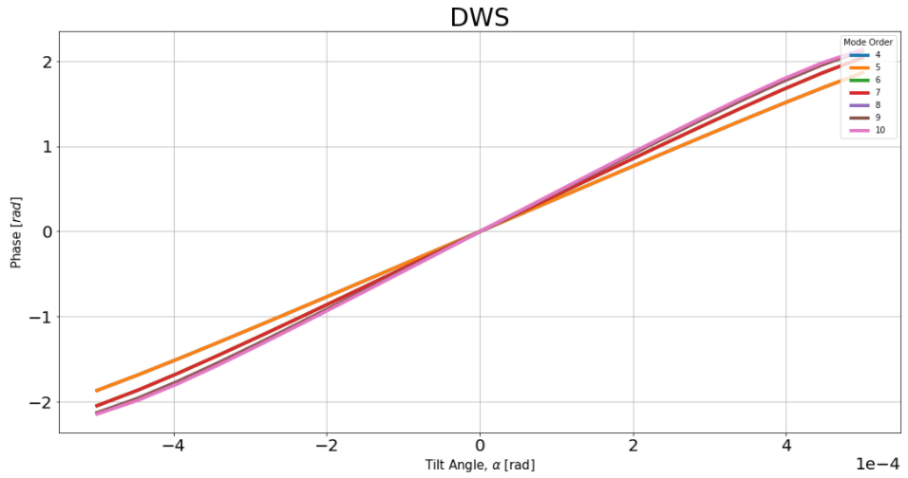
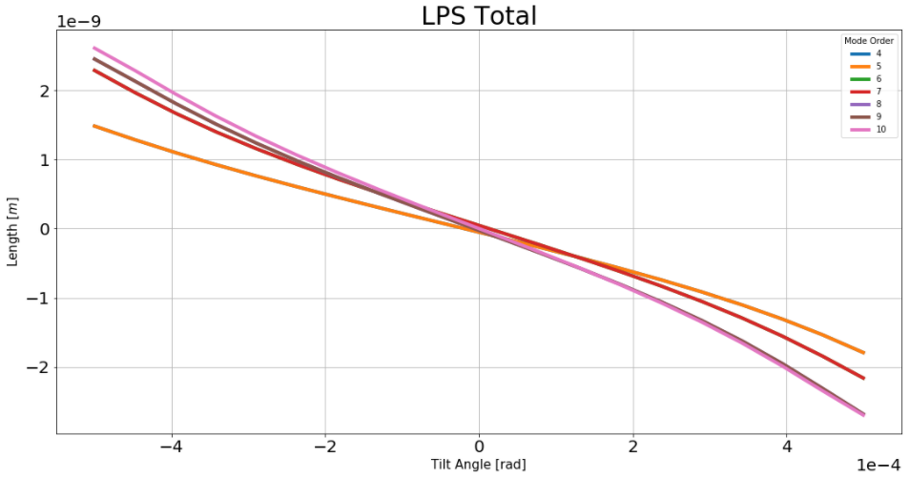

Slide 23
Tophat Mode Order 10

